Slide 1
Introduction to ‘R’ Programming Interfaces: R console and R studio
Info@stepupanalytics.com

Slide 2
AGENDA
History and evolution of R
Description of R interface
Description of R Studio interface

Slide 3


HISTORY AND EVOLUTION OF R
Origin in the Bell Labs in the 1970’s

Slide 4


HISTORY AND EVOLUTION OF R
R has developed from the S language
S Version 1
S Version 2
S Version 3
S Version 4
Developed 30 years ago for research
applied to the high-tech industry

Slide 5
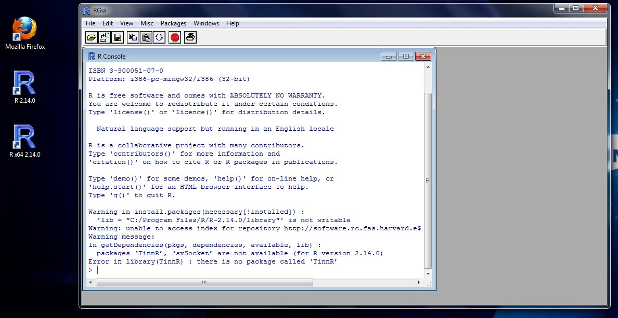
DESCRIPTION OF R INTERFACE
R console
RGui: R basic
interface
R desktop shortcut
R command line (space to write instructions)

Slide 6
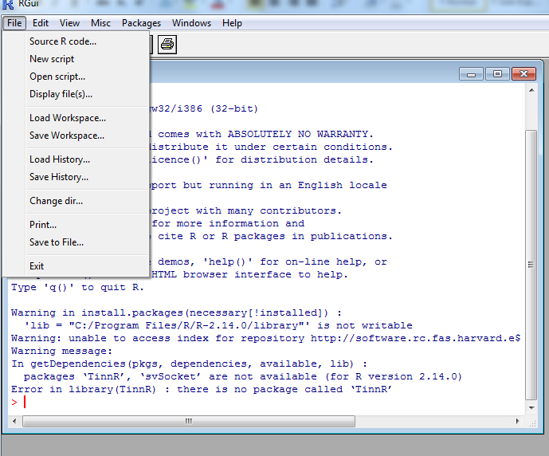
DESCRIPTION OF R INTERFACE
RGui menu: File tab
File tab: Usual basic and general operations

Slide 7
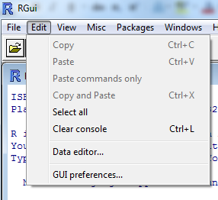
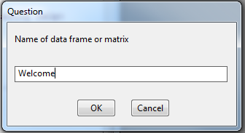

DESCRIPTION OF R INTERFACE
RGui menu: Edit tab
Data editor: entering the object’s name
Edit tab: basic and general editing
Results of the
data editor

Slide 8
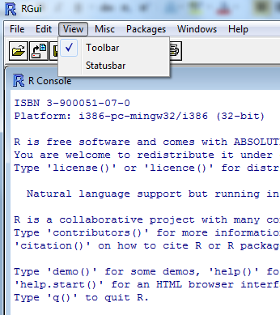
DESCRIPTION OF R INTERFACE
RGui menu: View tab
View tab: viewing Toolbar and/or Status bar

Slide 9
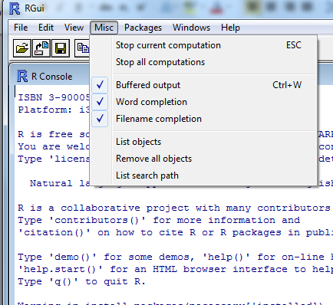
DESCRIPTION OF R INTERFACE
RGui menu: Misc tab
Misc tab: diverse operations

Slide 10
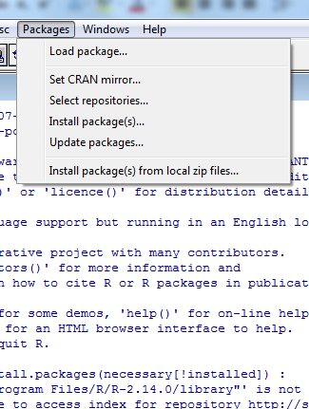
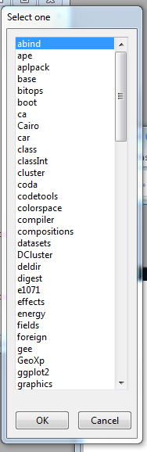
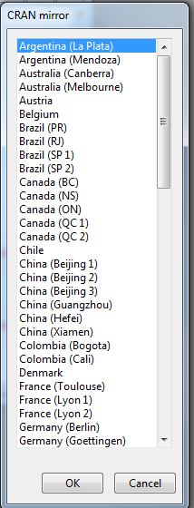
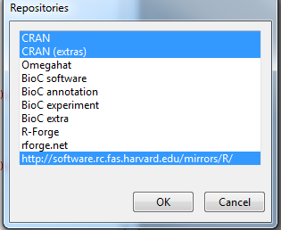
DESCRIPTION OF R INTERFACE
RGui menu: Packages tabs
Packages tab: adding functions to R foundation

Slide 11
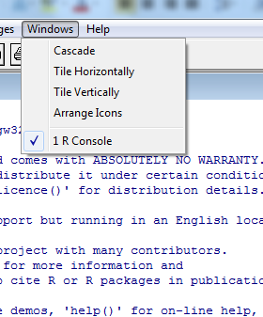
DESCRIPTION OF R INTERFACE
RGui menu: Windows tab
Windows tab: usual options to arrange the tiles

Slide 12
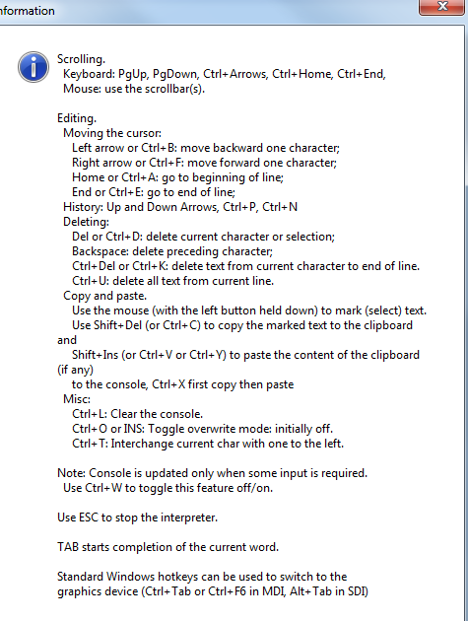
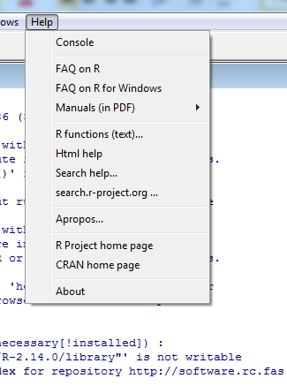
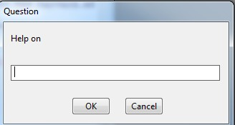
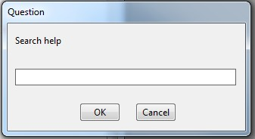
DESCRIPTION OF R INTERFACE
RGui menu: Help tab
Help tab: very important links to help

Slide 13
Installing R
Download R Package from
https://cran.r-project.org/
Click on the Windows specific link and finally the download of an executable file R-3.x.x.exe.
https://cran.r-project.org/bin/windows/base/R-3.5.3-win.exe
Notes:
On what all platforms are can be installed?

Slide 14
How to get help in R
R includes extensive facilities for accessing documentation and searching for help.
R Help: help() and ?
The help() function and ? help operator in R provide access to the documentation pages
To access documentation for the standard lm (linear model) function, for example, enter the command help(lm) or help("lm"), or ?lm or ?"lm" (i.e., the quotes are optional).
You may also use the help() function to access information about a package in your library — for example, help(package="MASS") — which displays an index of available help pages for the package along with some other information.
Help pages for functions usually include a section with executable examples illustrating how the functions work.
You can execute these examples in the current R session via the example() command: e.g., example(lm).
Notes:
What is the use of using ? in R?
How to get help for the package in R?
- help(package=“MASS”)
Why the example() command is useful in R?

Slide 15
Installing R Studio
Go on the official website of RStudio - https://www.rstudio.com/
Go to www.rstudio.com and click on the "Download RStudio" button.
Click on "Download RStudio Desktop."
Windows: Click on the version recommended for your system, or the latest Windows version, and save the executable file. Run the .exe file and follow the installation instructions.
https://download1.rstudio.org/RStudio-1.1.463.exe

Slide 16
R Studio Overview
The RStudio open source and commercial Integrated Development Environment is the premier IDE for the R programming language.
RStudio project already provides nearly all the desired features for an IDE, making it easier and more productive to use R.
The main components of an IDE are all nicely integrated into a four-pane layout
Console for interactive R sessions. Location were commands are entered and the output is printed
A tabbed source-code editor. Its as built-in text editor.
Environment & History Tab. It’s a interactive list of loaded R objects and shows list of key strokes entered into the Console
Files, Plots, Package, Help:
Files: File explorer to navigate folders
Plots: Output location for plots
Packages: List of installed packages
Help: Output location for help commands and help search window
Notes:
What is the benefit of using R Studio?
How many panes are available in R Studio?

Slide 17


